Slide 1

Project 4 - Presentation
Mike, Hattan, Muhammad

Slide 2
Individual Contributions
Mike
HATEOAS Link Implementation
Frontend Implementation
Hattan
HATEOAS Link Implementation
Updates to existing services
Documentation
State Flow Diagram
Muhammad
Customer Username/Password Authentication
Error and Exception Handling

Slide 3
Backend Changes
Took existing REST service implementation and added Hateoas link functionality
Allows “client” to know how to transition into the next state
Created a global Link class to hold the following HATEOAS link information:
rel => description of next transition (ex: Check Order Status)
action => http method (ex: GET)
uri => uniform resource identifier for next transition (ex: http://localhost:8081/orderservice/orders/)
type = > returned media type (ex: application/json)
Implemented links within each resource’s Activity class

Slide 4

Frontend Implementation
Project 4 required the addition of a front end to be used to simulate the users buying experience
Chose AngularJs which is front end application framework created by Google
Added “front-end” module in project that depends mainly on two files:
app.js => Contains controllers for interacting with backend services
index.html => HTML code for markup and buttons
Kept relatively basic to demonstrate how HATEOAS link usage in service calls help client applications

Slide 5
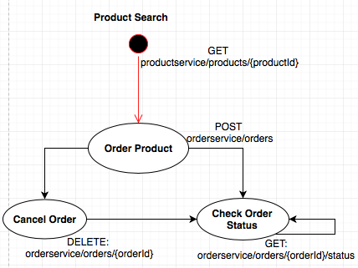
State Flow Diagram

Slide 6
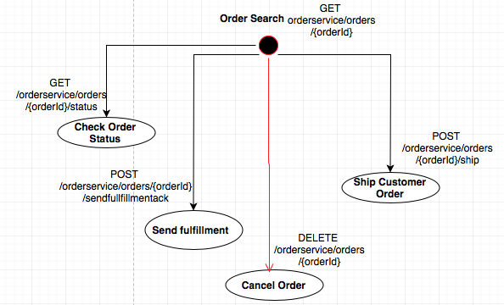
State Flow Diagram (cont.)

Slide 7


